Slide 1
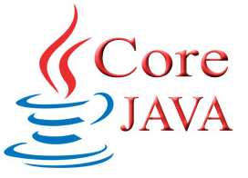
JAVA CORE PROJECT
JAVA APPLICATION
By :- Anshul Mehta
ayan Talesara
Ankit kelwa

Slide 2
java
Java programming language is a high-level language.
It is originally developed by “James Gosling” at ‘Sun Microsystems’.
Released in 1995 as Core component of Sun Microsystems java platform.
Java platform typically compiled to bytecode (Class File)that run on any Java Virtual Machine (JVM) regardless of computer architecture.
Java is guaranteed to be Write Once, Run Anywhere.

Slide 3
Java application
Calculator.
Picture Puzzle.
Number Puzzle.
Login System.

Slide 4
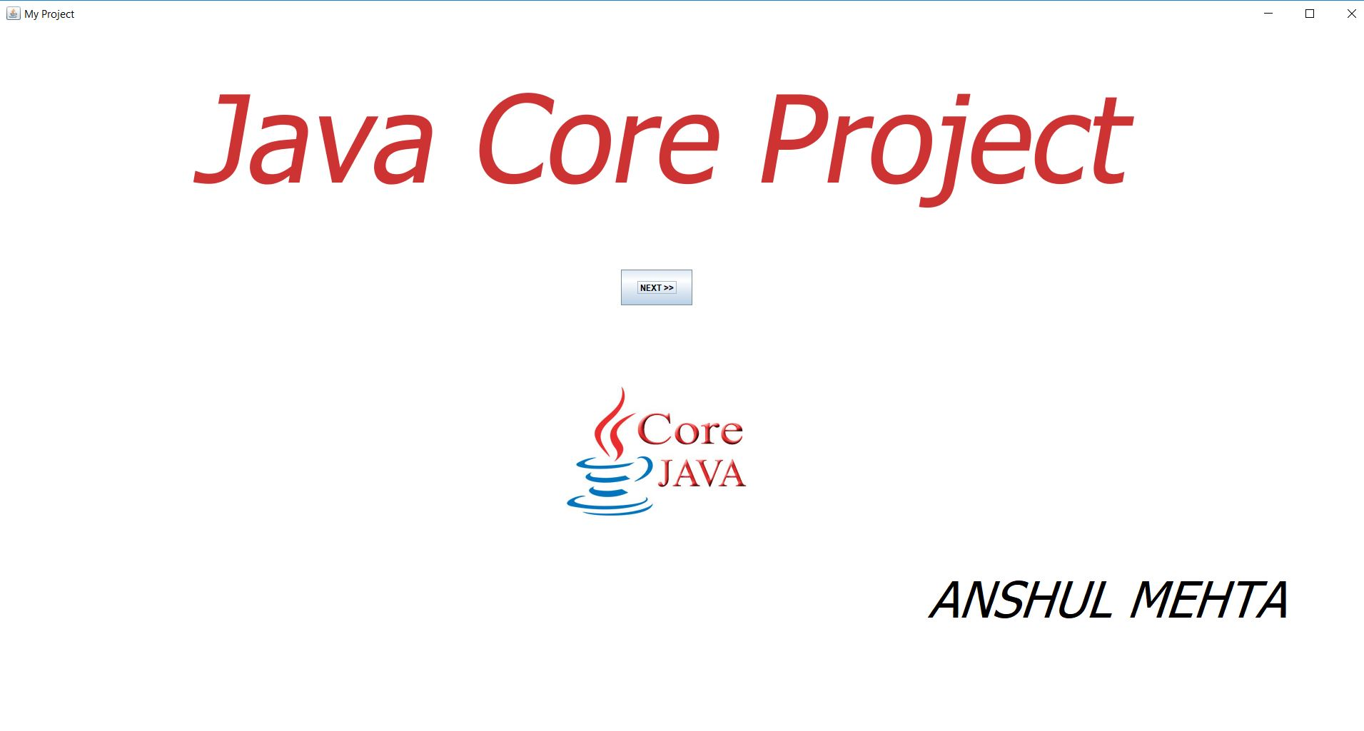
Overview

Slide 5
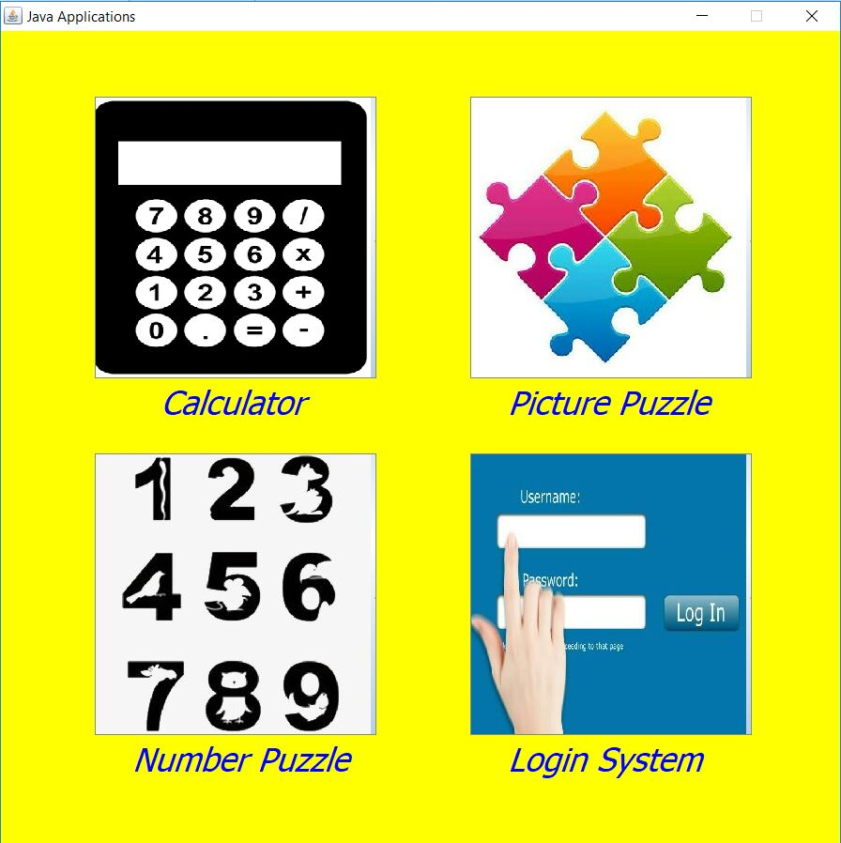

Slide 6
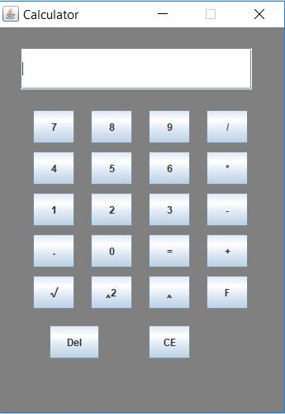
calculator

Slide 7

Picture puzzle

Slide 8
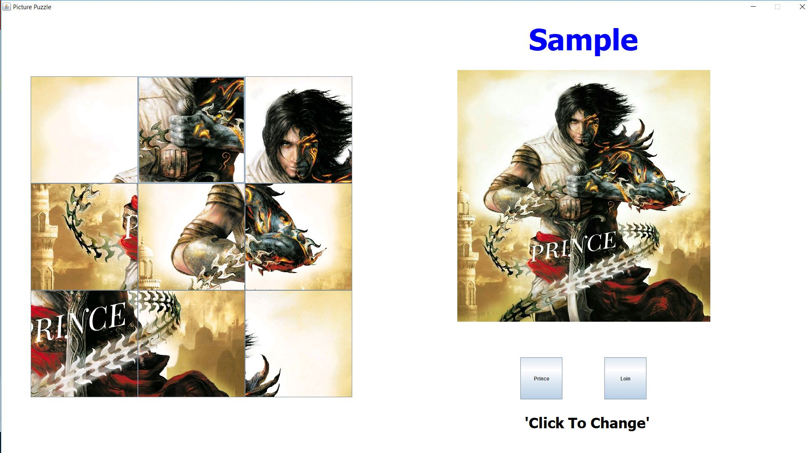
SNAPSHOT

Slide 9
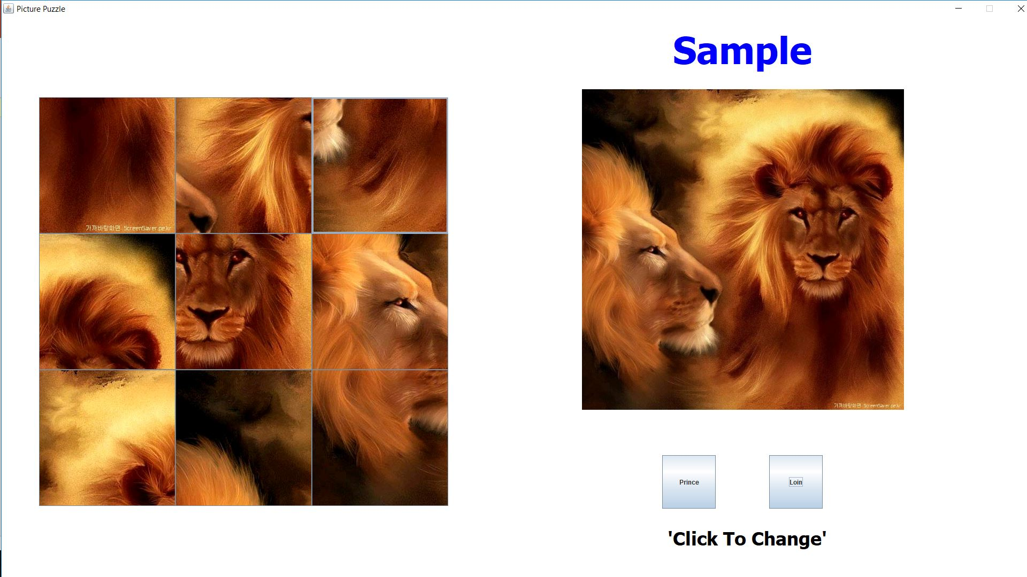
SNAPSHOT

Slide 10
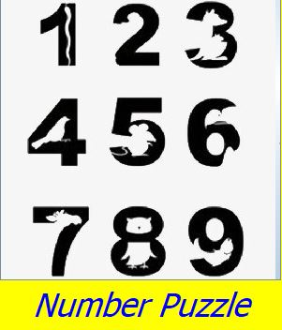
Number puzzle

Slide 11
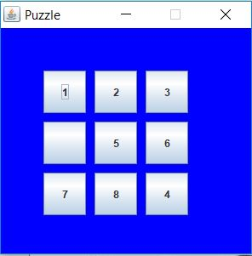
SNAPSHOT

Slide 12
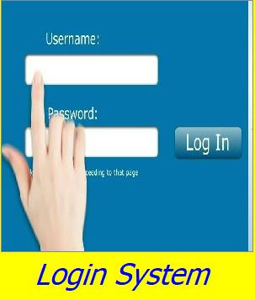
login system

Slide 13
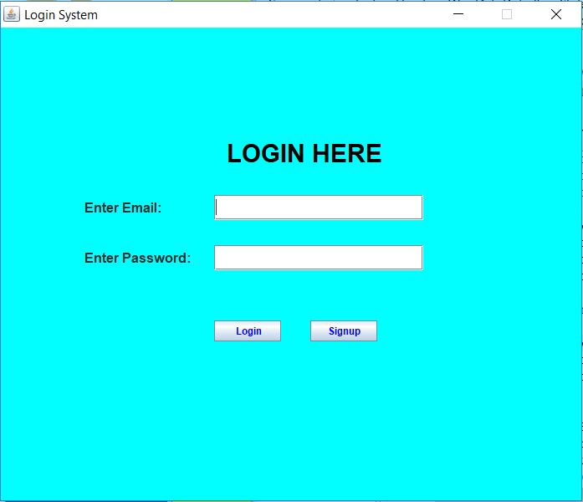
SNAPSHOT

Slide 14
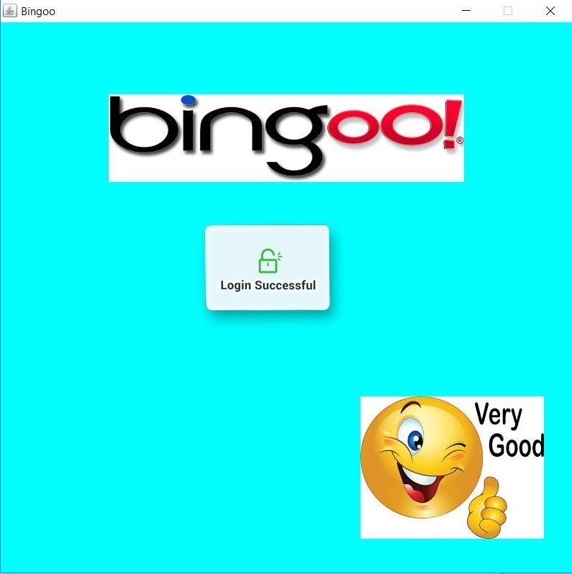
Login Successful
SNAPSHOT

Slide 15
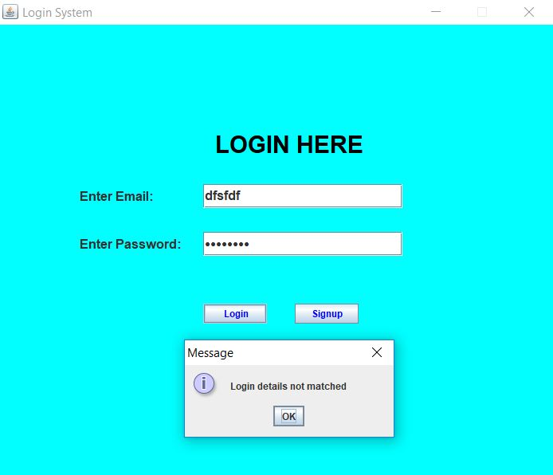
Login Unsuccessful
SNAPSHOT

Slide 16
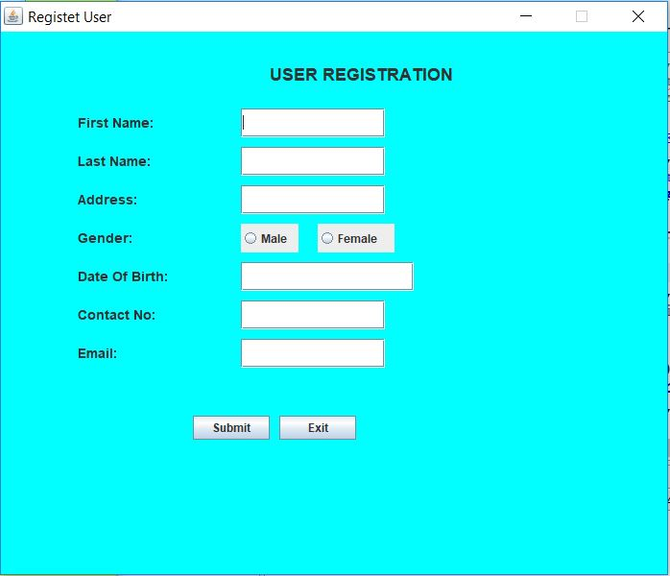
User Registration
SNAPSHOT

Slide 17
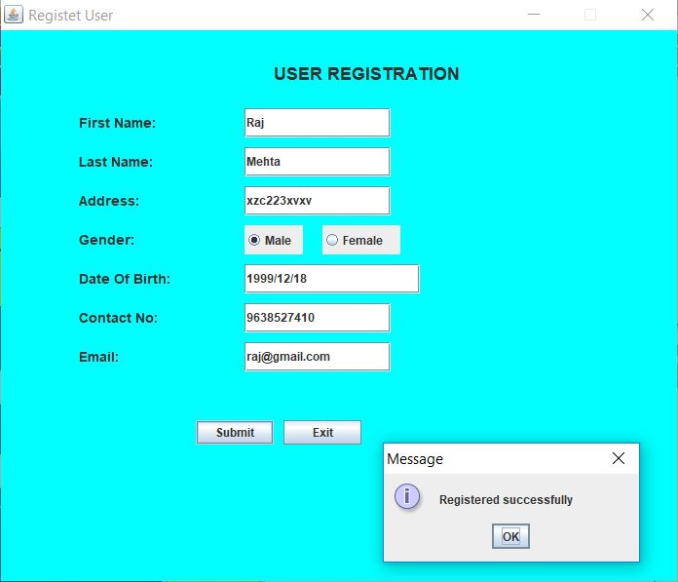
Registration Unsuccessful
SNAPSHOT

Slide 18
END
Thank You

